Slide 1
Airbnb
New York City
Presented by: Allison Deming, Alex McCambridge, Nolan Mercado and Mikayla Scott

Slide 2
01
02
Goals
Observations
03
04
Analysis
Summary and Conclusion
Specifying our goals, and preparing data for the analysis
Observation and Visualizations
Explaining the types of analysis and how we arrived at the models
Summary and Final thoughts of our findings.

Slide 3
About the Data
The data set consists of a total of six CSV files that contain data relating to Airbnb rentals located in the five boroughs of New York. The data set comes from a website named “Inside Airbnb.” The company markets themselves as a mission-driven project that provides data and advocacy about Airbnb's impact on residential communities.
The data can be found at this website: http://insideairbnb.com/get-the-data
The data has one file named “listings.csv” which contains a summary of information and metrics for listings in New York City.
Another data file named “reviews.csv” is a summary of review data and listing ID. Both listings and review have a truncated, or smaller version that is provided in CVS form.
A fifth CSV file with the top 300 tourist destinations was created along with their GPS Coordinates to provide information of the relationship between those destinations and the listings themselves.
The sixth and last data file is named, “calendar.csv.” This file contains detailed calendar data which shows those Airbnb rentals that are available on certain dates.
These datasets were downloaded and imported into RStudio which were cleaned up and analyzed to plot the data and model predictions

Slide 4
01
Goals
Specify the Goals of the Analysis

Slide 5
Goals
How much value does each amenity add to the price of an AirBnB?
Is there a relation between the sentiment of a review, and the price of an AirBnB and the proximity to a large tourist attraction?
How much effect does the time of year have on the cost of an AirBnB, the number of reviews written, and the sentiment of the reviews?
Where are the affordable AirBnBs located in the five boroughs?
Trying to Predict if a given location will be available for 365 days out of the year?

Slide 6
02
Analysis
Data Analysis

Slide 7
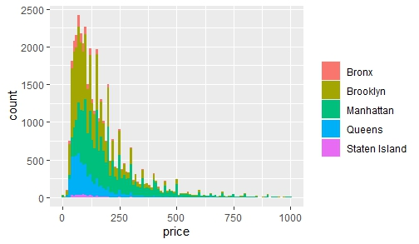
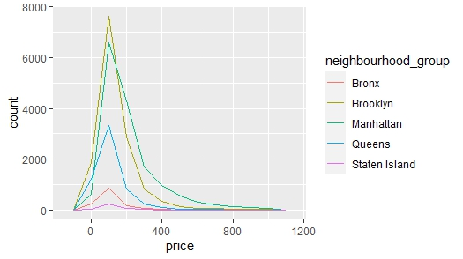
Price Visualization
Number of Listings by Price by Borough

Slide 8
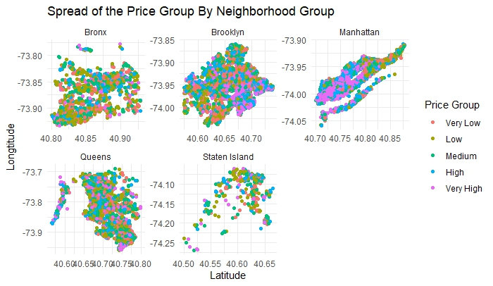
Discretized Boroughs

Slide 9
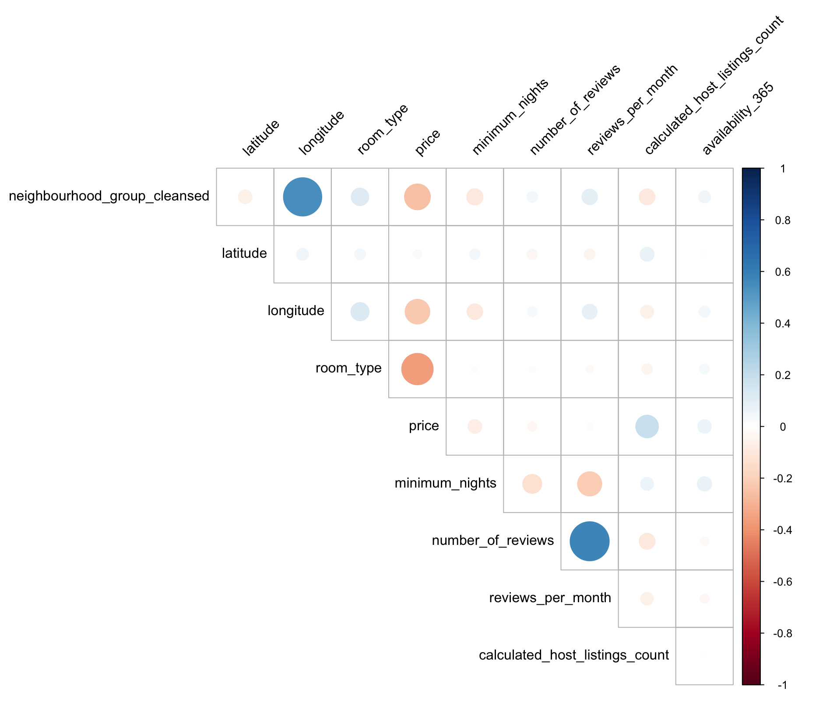
Correlation Matrix

Slide 10
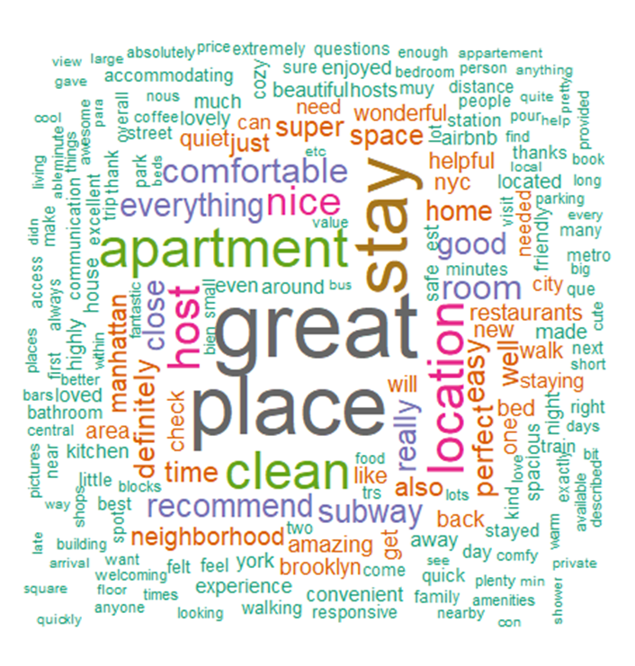
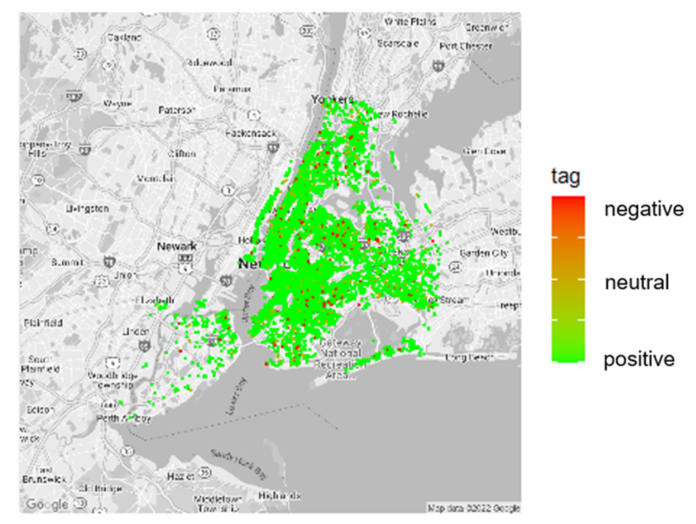
 | Top Recurring Words
Associated Words (AW) | Stay | Apartment | location | clean | host | Manhattan | comfortable | perfect | wonderful
AW 1 | Definitely | Subway | slide | quiet | blankets | jersey | bed | bundled | gilding
AW 2 | Enjoyed | Walk | tendency | bathroom | abnormally | boarders | beds | miserable | opulent
AW 3 | Mad | Restaurants | UberEATS | room | balled | companies | felt | pants | overstate
AW 4 | Throughout |  | delivery | everything | blood | shore | kitchen | prove | specimen
AW 5 | Night | NYC | frustrating | kitchen | corrected | skyscraper | well | purchased | verbally
AW 6 | Home | Kitchen | tent | towels | dried | SuperShuttle | room | sweaters | wickedly
AW 7 | City | Neighborhood | fence | sparkling | heats | tunnels | subway | trekking | hexagonal
AW 8 | Extremely | Large | parties | safe | lectured | minutes | home | city | linsey

Slide 11
03
Models
Modeling the Data for Predictions and in depth Analysis

Slide 12
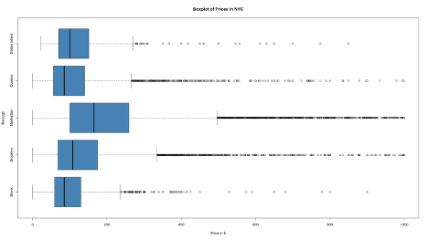
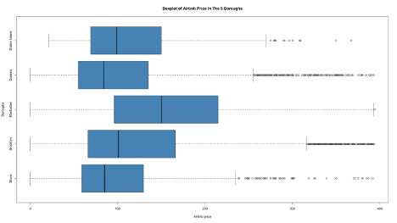
Airbnb Pricing Group by K-Means
A large number of price outliers in the data set
Manhattan has the largest group of outliers
Cleaning method
Lower = Quantile 1 – 1.5 * IQR
Upper = Quantile 3 + 1.5 * IQR

Slide 13
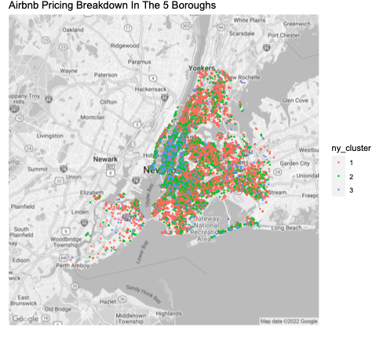
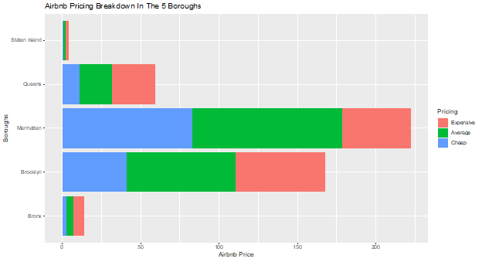
Airbnb Pricing Group by K-Means
Kmeans model (k =3)
Expensive, Average, & Cheap
Majority of the Airbnb pricing falls into the Average pricing
Location, Location, Location

Slide 14
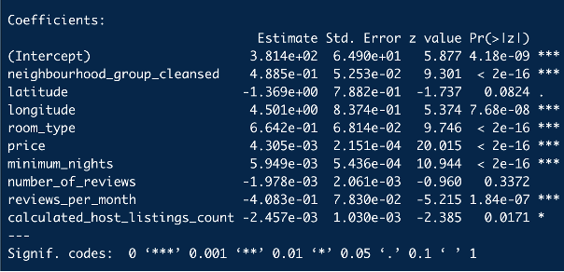
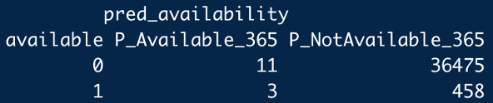
Logistical Regression

Slide 15
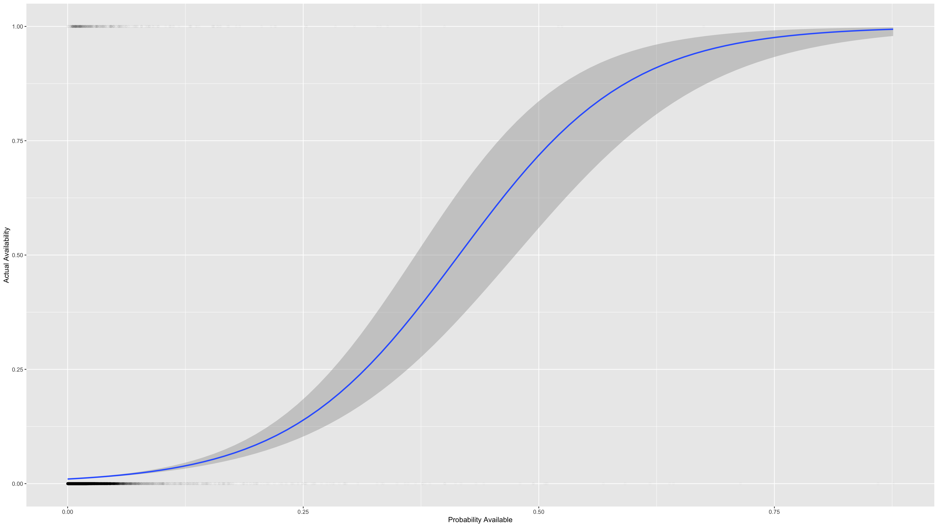

Slide 16
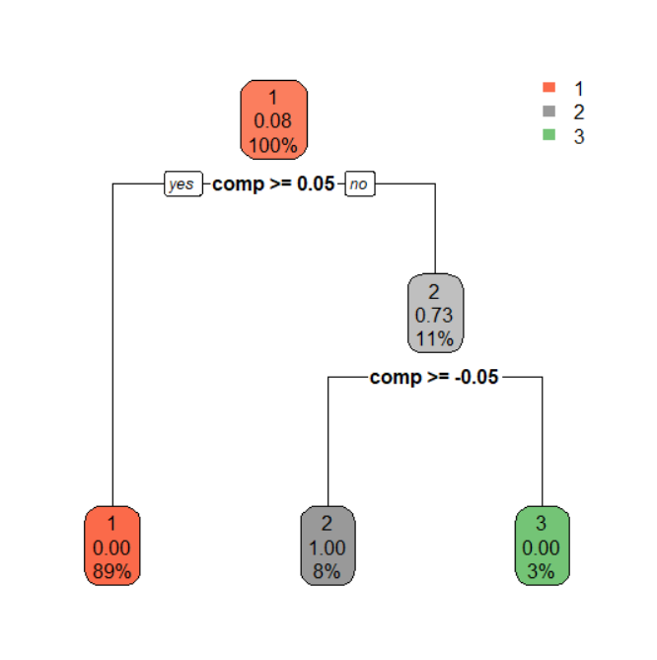
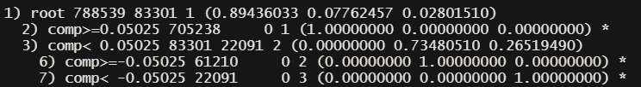

Sentiment Decision Tree
+
-

Slide 17
04
Summary and Conclusion
Summarizing our Findings and Final Thoughts

Slide 18
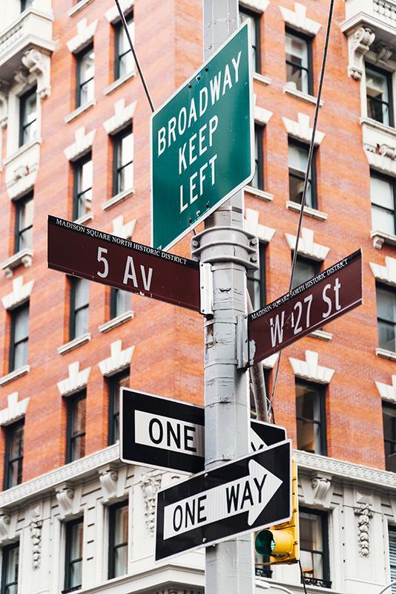
Summary and Conclusion
During our analysis we were able to use Decision Trees, K-Means Clustering, Sentiment Analysis, and multiple more basic methods for visualization of the data, both big and small.

Slide 19
Q&A
Questions and Answers

Slide 20
THANK YOU!

